Slide 1

Go, change the world
RV College of
Engineering
IoT enabled Monitoring of EV Charging Station
16EC73P : BE Minor Project Phase 1 Presentation
Manjunath G 1RV17EC071
Rakshith J.C 1RV17EC120
Srivaths J.M 1RV17EC164
Guide Name:Dr.Govinda Raju M.
Designation: Assistant Professor
Department of Electronics and Communication Engineering
*
Department of ECE
‹#›

Slide 2

Go, change the world
RV College of
Engineering
Outline
Introduction
Motivation
Literature Survey
Problem Statement
Objectives of the project
Methodology
Project timeline
References
*
Department of ECE
‹#›

Slide 3
Go, change the world
RV College of
Engineering
Introduction
With the increasing popularity and demand for Electric Vehicles,we arrive at a commonly raised issue which is the charging of vehicles.
IOT is a system of interconnected devices connected to the internet,so they can interact,collaborate exchange data with each other
The introduction of IOT has revolutionized the global industries in each and every aspect making electronics and network engineers a crucial element required to maintain the proper functioning of this diverse ecosystem of machines.
This makes it a must for proper collaboration among engineers of various disciplines and reduces human interaction with machine.
*
Department of ECE
‹#›

Slide 4
Go, change the world
RV College of
Engineering
Introduction
IOT with cloud integration provides a user-friendly platform to monitor process of charging.
The real-time data collected by this process allows us to calculate various parameters with the combined effort of cloud computing and estimation algorithms
With the above points into considerations and put together can be defined as a smart system
*
Department of ECE
‹#›

Slide 5
Go, change the world
RV College of
Engineering
Motivation
Major drawbacks associated with extensive charging time of electric vehicles on which sustainable solution is the need of the hour.
Lithium ion batteries are highly inflammable which poses a fatal security risk while operating and hence requires constant monitoring while charging.
Need for user-friendly and foolproof interface to monitor the charging at fingertips.
*
Department of ECE
‹#›

Slide 6
Go, change the world
RV College of
Engineering
Literature Survey
Sl No | Paper Title Journal Name, Year | Major findings / observations
1 | Open IoT Ecosystem for Smart EV Charging. Global Internet of Things Summit (GIoTS) 2018 | Basic building blocks of IoT Specifi communication protocols(MQTT)i.e O-MI/O-DF using API resource access Intercommunication between edge/node and handling the services
2 | Committee Report on Standardization of Public EV Chargers. Government of India, Ministry of Heavy Industries and Public Enterprises 2017 | Public AC metered outlets and public DC fast chargers specifications. Billing and Tariffs requirements. User Interface and display requirement. Safety standards and functional requirements.
3 | EV fast charging stations and energy storage technologies: A real implementation in the smart micro grid paradigm. 2014 | DC charger levels (lvl 1 & 2). Smart micro-grid implementation using LabView.
*
Department of ECE
‹#›

Slide 7
Go, change the world
RV College of
Engineering
Literature Survey
Sl No | Paper Title Journal Name, Year | Major findings / observations
4 | Charging Buddy - A Secured Charging Station Using Internet of Things. 2nd International Conference on Innovative Mechanisms for Industry Applications (ICIMIA). 2020 | Creation Of A Django Server for storage of registered customers Checking the availability of slots Guiding to the nearest available station
5 | A new vehicle-to-grid system for battery charging exploiting IoT protocols.IEEE International Conference on Industrial Technology (ICIT). 2015 | Implementation of a Pusblish/Subscribe paradigm for request access Maintaining a low power microcontroller and using various power saving methods such as sleep during inactivity
*
Department of ECE
‹#›

Slide 8
Go, change the world
RV College of
Engineering
Literature Survey
Sl No | Paper Title Journal Name, Year | Major findings / observations
6 | Battery Management Systems in Electric and Hybrid Vehicles.Energies — Open Access Journal 2011 | Battery management system. State of charge of battery. State of health and state of life of battery.
7 | An efficient scheduling for low power in real-time embedded systems.International Conference on Advanced Technologies for Communications.2012 | The edge(node) must consume as little power as possible. This can be achieved by keeping the node inactive as long as possible and also the implementation of efficient scheduling algorithms
*
Department of ECE
‹#›

Slide 9
Go, change the world
v
RV College of
Engineering
Literature Survey
Sl No | Paper Title Journal Name, Year | Major findings / observations
8 | Introduction of Electric Vehicle Charging Stations to University Campuses: A Case Study for the University of Georgia 2017 | Electric vehicle usage analysis Electric vehicle charging station charging behaviour EV charging infrastructure to college campus
*
Department of ECE
‹#›

Slide 10
Go, change the world
RV College of
Engineering
Problem Statement
Development of efficient, safe and economical methods for monitoring mass EV charging through public charging stations
*
Department of ECE
‹#›

Slide 11
Go, change the world
RV College of
Engineering
Objectives of the Project
To locate the nearest available charging station by taking into consideration the energy remaining
To calculate the energy consumed from the charging grid and generating invoice according to the user’s billing details with a centralized cloud computing server.
To alert the user at the event of unexpected outcome
Easy access to variety of options via dedicated application/software interface to minimize human interference
*
Department of ECE
‹#›

Slide 12

Go, change the world
RV College of
Engineering
Design Methodology
IOT node consisting of sensors and control unit
Router to establish internet connection to the IOT node
Set up a firewall encryption to ensure network security and data privacy
Maintain a remote data center and cloud database
Easily accessible User-Interactive Application Development
*
Department of ECE
‹#›

Slide 13
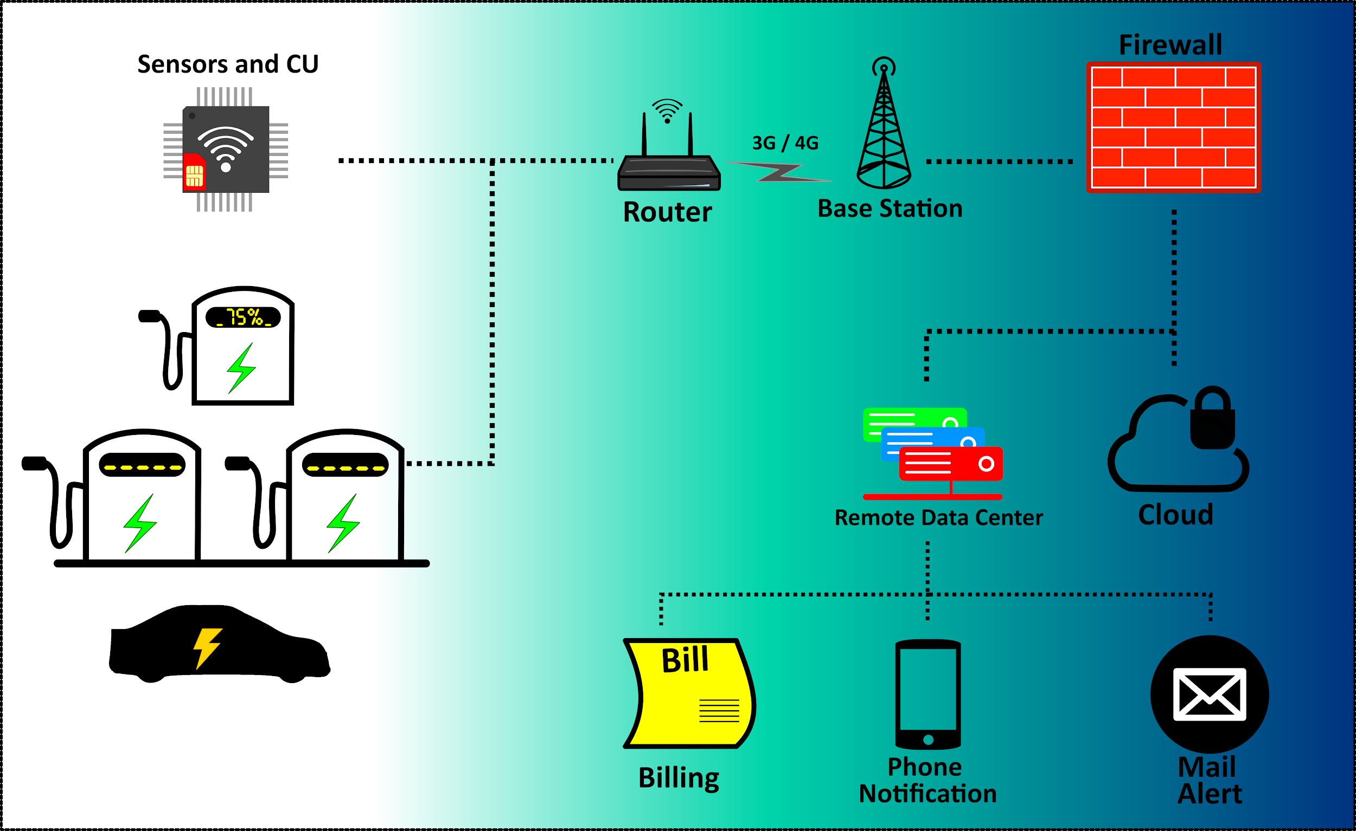
Go, change the world
RV College of
Engineering
Fig 1
*
Department of ECE
‹#›

Slide 14
Go, change the world
RV College of
Engineering
Details of Software / Hardware
ESP32 Development board with Wifi and Bluetooth connectivity.
Google Firebase - Cloud server database
Microsoft Visual Studio - Software Development
Android Studio - Application Development
*
Department of ECE
‹#›

Slide 15
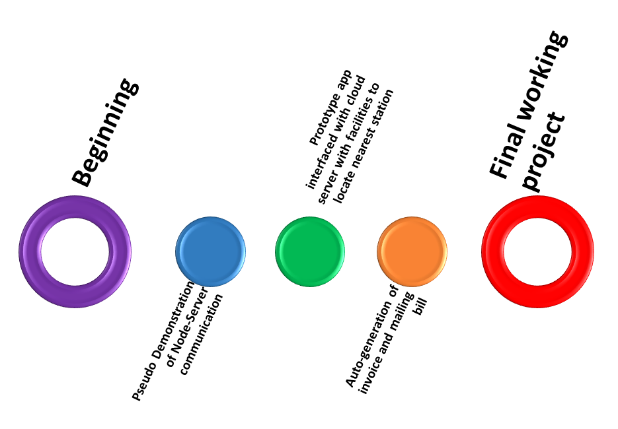
Go, change the world
RV College of
Engineering
Timeline of the Project
Sept,2020
20-10-2020
30-10-2020
20-11-2020
10-12-2020
*
Department of ECE
‹#›

Slide 16
Go, change the world
RV College of
Engineering
References
Sl No | Author, Title of paper, Journal | Year
1 | Karpenko. A., Kinnunen.T, Framling. K, & Dave:-Open IoT Ecosystem for Smart EV Charging. | 2018
2 | Ambilpure S., Chhapra U., Chavan A., & Kapse D..:- Charging Buddy - A Secured Charging Station Using Internet of Things. | 2020
3 | ESP32 Datasheet, Espressif Systems. | 2020
4 | Fachechi A., Mainetti L., Palano L., Patrono L., Stefanizzi M. L., Vergallo, R.Gadh:-A new vehicle-to-grid system for battery charging exploiting IoT protocols. | 2020
5 | D. Sbordone I. Bertin ,B. Di Pietra ,M.C. Flavo, A. Genovese, L. Martirano :- EV fast charging stations and energy storage technologies: A real implementation in the smart micro grid paradigm. | 2014
6 | Dinh-Duc A.V. An efficient scheduling for low power in real-time embedded systems. | 2012
*
Department of ECE
‹#›

Slide 17
Go, change the world
RV College of
Engineering
Thank You
*
Department of ECE
‹#›

